Slide 1
A11Y & the 3 Bears of AI
AI
WCAG
ML
CV
A11Y
Notes:
Is the use of Artificial Intelligence (AI) to solve accessibility barriers just a fairy tale? Will AI solve nothing? Will AI solve everything? Or will AI refined by human intelligence and ethics be the path to systemic accessibility for real?
This is incredibly important, y’all! As an industry, we’ve been working to make digital accessibility a reality for over 20 years, and I’m not satisfied with our progress to date. Are you?* If we keep trying to solve the digital accessibility problem the way we’ve been trying since 1999, I predict we will never win.
But all is not lost. I believe there is a Goldilocks Zone for the ethical use of AI in digital Accessibility. Join me as we explore the frightening dangers and amazing opportunities that await. Then, decide for yourself where AI fits into our future.
*”96.3% of home pages had detected WCAG 2 failures!” - WebAIM Million 2023

Slide 2
Glenda Sims
the goodwitch of accessibility
deque.com
#a11y

Slide 3
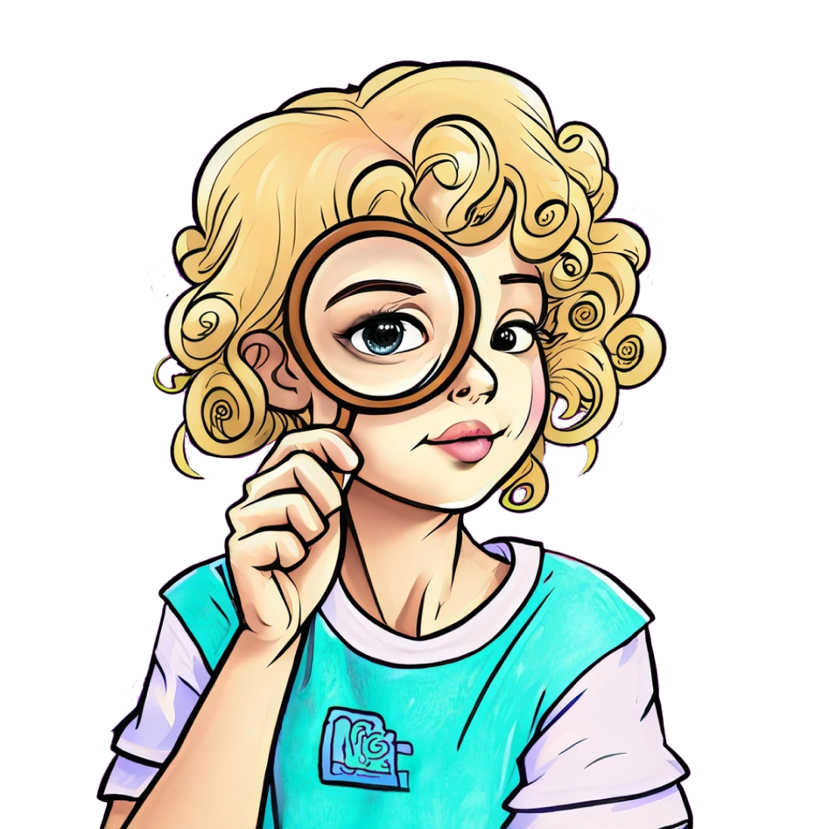
Learning Objectives
What is Artificial Intelligence (AI)
AI and digital accessibility
Clear and present dangers of AI
Ethical AI in digital accessibility
Goldilocks Zone

Slide 4
What is AI?
Artificial Intelligence (AI)

Slide 5
AI Defined
Artificial Intelligence (AI):
Computer systems able to perform tasks
on their own that normally require human intelligence, such as:
Visual perception
Speech recognition
Decision-making
Translation between languages
- Oxford Dictionary

Slide 6
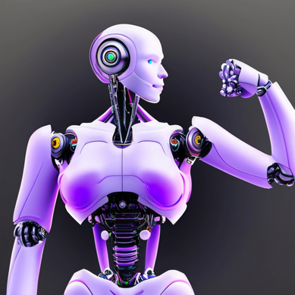
AI Narrow/Weak or General/Strong
Narrow/Weak AI
inferior to human intelligence
can solve 1 narrow specific problem
many real examples today
General/Strong AI
equal or better than human intelligence
probably does not exist today

Slide 7
Machine Learning (ML) & Computer Vision (CV)
Machine Learning (ML)
Process, analyze, interpret data
Structured database
Curated & tagged by real humans
Example: Email spam filtering
Computer Vision (CV)
Process, analyze, interpret visuals
Structured database of visuals
Curated & tagged by real humans
Example: face recognition
Artificial Intelligence
Computer Vision
Machine Learning

Slide 8
Supervised & Reinforcement ML & Spam
Machine Learning (ML) in Narrow AI
Built & Supervised by Humans:
Structured database of spam
Decision model created by humans
Reinforcement from Humans:
Positive/negative human feedback
Learns and improves accuracy
Example: Spam Filter
Filtered 200+ spam emails over 30 days
Supervised: database of spam vetted by humans
Reinforce spam filter
Filter gets better as you mark an email as spam (or indicate something should not be spam)

Slide 9
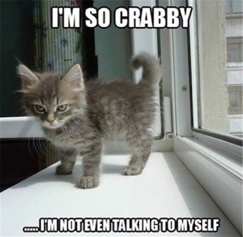
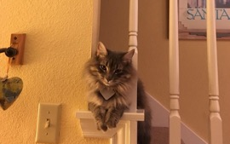
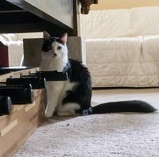
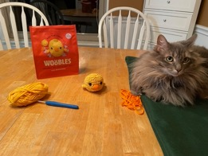
Computer Vision (CV) & Cats
100+ correct
Computer Vision (CV) in Narrow AI
Decision models based on structured image data
Structured database of cat images vetted by humans
Enables CV app to learn and improve accuracy
Tuned by human input
Example: Photos Search Feature
Search 12,000+ photos for “cat”
Result: 100+ photos CV thinks have a cat
Accuracy: Only 1 photo did NOT have a cat in it
1 wrong

Slide 10
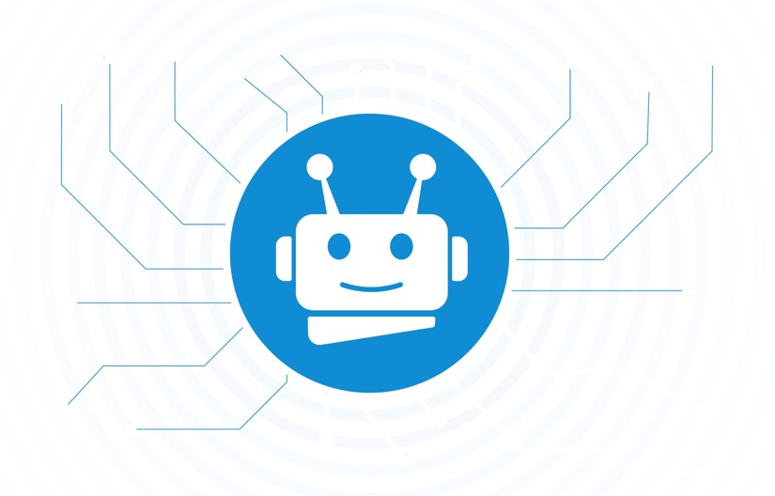
What Narrow/Weak AI Examples Do You Use?
Driving:
Lane keep assistance
Blind spot indicator
Collision avoidance braking
Mobile Phone:
FaceID
Predictive text
Email
Spam filtering
Security
Fraud detection
Smart Speaker:
Conversational AI (speech recognition and natural language understanding)
Image Recognition:
Tagging people in photos (facial rec)
Search using image (instead of words)
Sound Recognition Examples:
Automatic captions/transcripts
Filter out background sounds

Slide 11
Generative AI
Generative AI can learn from existing artifacts to generate new, realistic artifacts (at scale) that reflect the characteristics of the training data but don’t repeat it.
- Gartner
Can produce new content, including text, software code, images, video, music, and speech.

Slide 12
Are you ready for the AI Tsunami?
It is already hitting our a11y shores

Slide 13
AI: Act Decide Monitor
Amy Webb, SXSW 2023

Slide 14
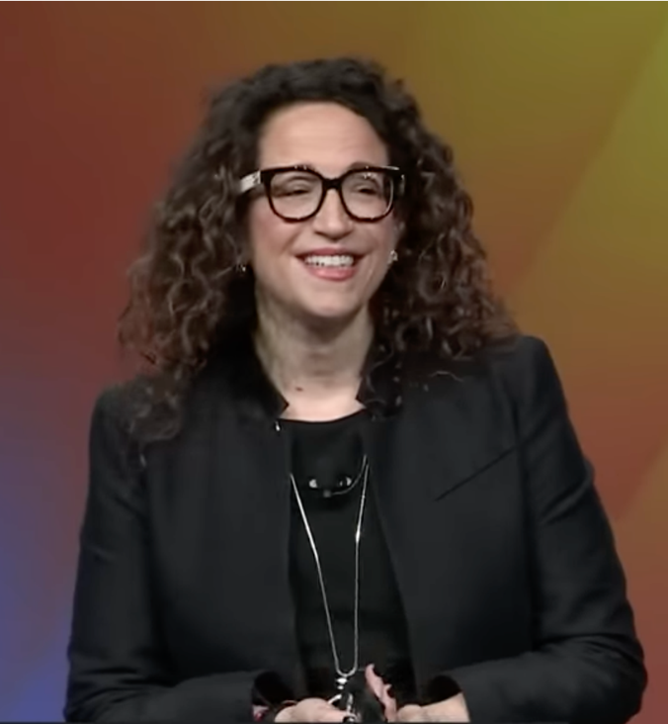
Amy Webb’s 2023 Emerging Tech Trend Report
It is the end of the internet as you know it
We’ve entered the assistive computer era
So much change is happening, you cannot just sit back & watch
ADM Tool
Act
Decide
Monitor
Use ADM to prioritize your actions
Notes:
https://www.youtube.com/watch?v=vMUpzxZB3-Y

Slide 15
Let’s Apply Amy’s ADM to AI in our A11Y Industry
ACT Risk without Action! | Decide Near-Term Opportunity or Risk | Monitor Long-Term Opportunity or Risks
Previously unseen immediate benefit to A11Y Inflection point is imminent New threat or risk is imminent | Could disrupt A11Y Meaningful impact on A11Y Near-term financial, operational, regulatory risk or opportunity | Potential for financial, operational or regulatory disruption Knock-on effects could shape A11Y Could pose novel A11Y risks
What requires action now? | What needs a decision? | What must we monitor?
Notes:
Inflection point – big change
Knock-on effects – secondary, indirect, cumulative

Slide 16
A11Y cannot be an AI spectator this year

Slide 17
A11Y cannot be an AI spectator this year or ever again

Slide 18
What can AI do for A11Y?

Slide 19
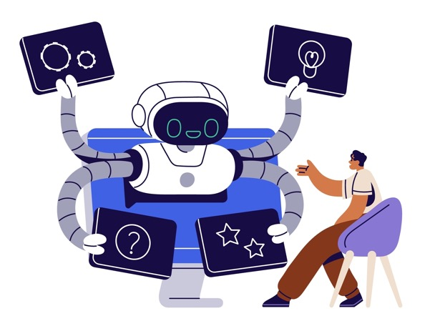
Narrow AI Can Optimize A11Y Testing
Computer Vision can “look” at rendered UI
Table cell looks like a header but not marked as <th>
Looks like a button but is not keyboard accessible
Text in image does not meet color contrast and more…
Sift through mountains of data to pinpoint what needs HUMAN review

Slide 20
Must Use Narrow AI in Auto A11Y Testing
Decision is simple
A 12-year-old human + simple decision model
Correctly decide pass or fail in seconds
Tons of data available To train/test AI model

Slide 21
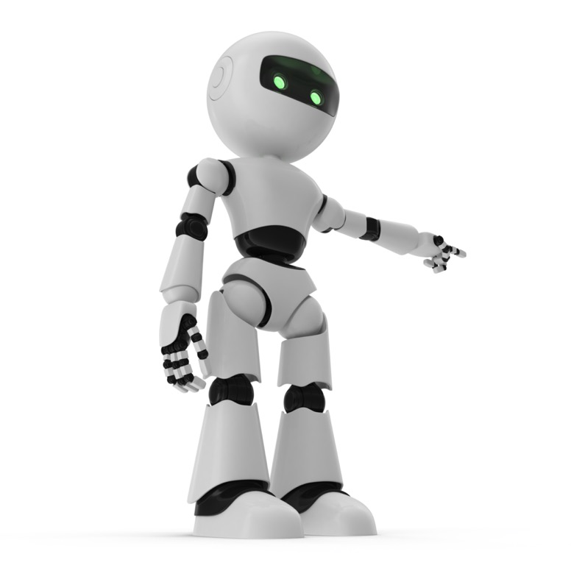
Narrow AI finds keyboard inaccessible “button”
This looks like a button
a DIV (no role) only works with a mouse
Narrow AI Machine Learning compares this DIV to other curated examples of inaccessible “buttons” built with DIV
Computer tries to press “button”
If button cannot be activated:
Report a WCAG 2.x issue for SC 2.1.1 Keyboard

Slide 22
Wait! I’ve got so many questions!

Slide 23
AI Real & Present Dangers

Slide 24
Content Advisory: Bias, Discrimination

Slide 25
AI Dangers (3 Bears of AI)
Ethics
Bias
Over and Under Reliance

Slide 26
AI & Ethics
“In no other field is the ethical compass more relevant than in artificial intelligence. These general-purpose technologies are re-shaping the way we work, interact, and live. The world is set to change at a pace not seen since the deployment of the printing press six centuries ago. AI technology brings major benefits in many areas, but without the ethical guardrails, it risks reproducing real world biases and discrimination, fueling divisions and threatening fundamental human rights and freedoms.” – UNESCO United Nations Educational, Scientific and Cultural Organization
Notes:
https://www.unesco.org/en/artificial-intelligence/recommendation-ethics

Slide 27
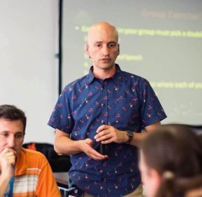
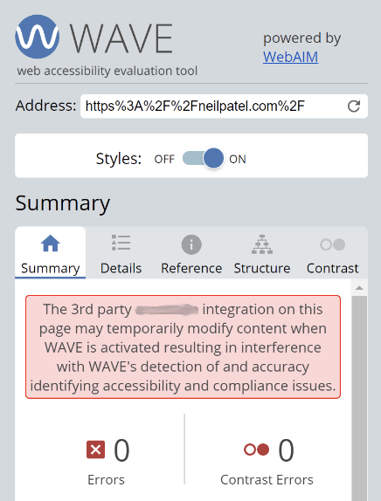
AI Ethics in A11Y: You decide
New Low in the Accessibility “Industry:” Overlay Company Sues Globally-Recognized Accessibility Expert – Lainey Feingold.
The 3rd party REDACTED2 integration on this page may temporarily modify content when WAVE is activated resulting in interference with WAVE's detection and of and accuracy identifying accessibility and compliance issues
Notes:
New Low in the Accessibility “Industry:” Overlay Company Sues Globally-Recognized Accessibility Expert – Lainey Feingold
REDACTED1 sued Adrian Roselli to stop him from expressing his professional opinion about the REDACTED1 solution that uses AI
https://overlayfalseclaims.com/anti-competitive-behavior.html
2 different Overlay Companies (REDACTED2 & REDACTED3) deployed code that interfered with the results of the WAVE testing tool.

Slide 28
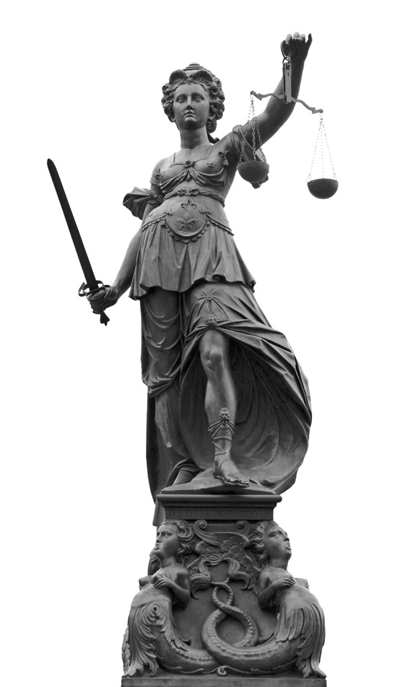
AI & BIAS
Bad Bias in AI
AI resume screening
Facial recognition
Bank loan approvals
Garbage in garbage out
Ethical Counter Bias in AI
Identify and zero out the bias factors
Inclusive data
Transparency in data store
Auditing process
Diversity in workforce

Slide 29
Could we use AI to model decisions that are ethical and consistently support human rights?

Slide 30
AI & Over Reliance

Slide 31
Are we winning at A11Y?

Slide 32
“96.3% of home pages had (automated) detected WCAG 2 failures!” - WebAIM Million 2023

Slide 33
Will we ever achieve digital a11y?
Notes:
30 years in, we’re not winning
Do you think we can solve the digital a11y problem the way we’ve been trying for the last 30 years?

Slide 34
Quiz Time: True or False?
______ Accessibility can be fully automated today to test for WCAG 2.1 A/AA and fix all issues, keeping a website accessible at all times.
______ There are many real-world examples of weak/narrow AI providing reasonably good accuracy today.
______ Machine Learning (ML) and Computer Vision (CV) are worthless to use in accessibility testing today.
______ A company that sells an AI accessibility solution sued an accessibility expert to stop him from expressing his professional opinions about the dangers of overlays.

Slide 35
Quiz Time: Answers
(False) Accessibility can be fully automated today to test for WCAG 2.1 A/AA and fix all issues, keeping a website accessible at all times.
(True) There are many real-world examples of weak/narrow AI providing reasonably good accuracy today.
(False) Machine Learning (ML) and Computer Vision (CV) are worthless to use in accessibility testing today.
(True) A company that sells an AI accessibility solution sued an accessibility expert to stop him from expressing his professional opinions about the dangers of overlays.

Slide 36
Ethical AI in A11Y Today

Slide 37
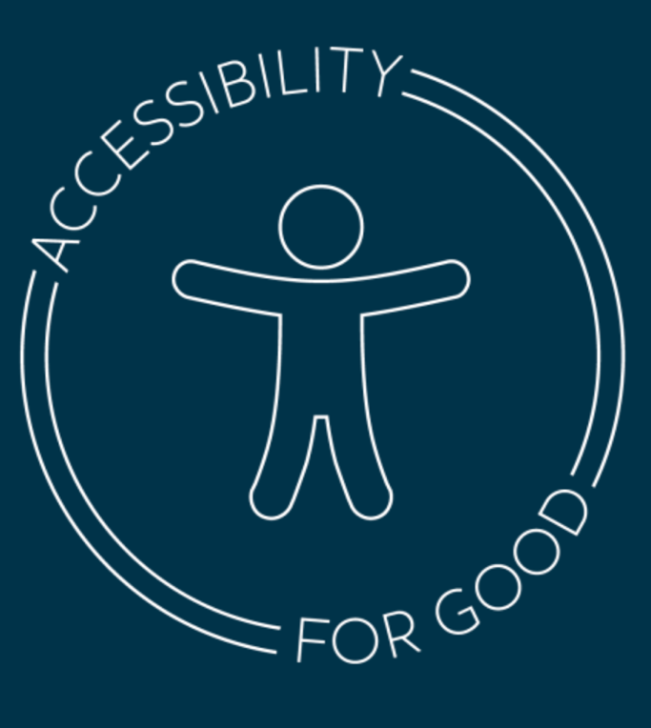
Deque’s Investment in AI for Digital Equality
Our approach to AI is human centric
Greatest accuracy + very high ROI
Dedicated AI expert team < humans
AI training data
Over 5,000,000 individual object labels
Very high quality
Growing every minute
Allow humans to overrule (teach) our AI
Notes:
Our approach to AI is human-centric because it provides the greatest accuracy in the results generated by the solution while delivering a very high ROI to users. We use AI in multiple ways (object detection, OCR, visual text & background rendering - including in different UI states) & combine it with heuristics but ultimately allowing humans to overrule our ML. This enables us to go beyond what is possible with pure heuristics, with zero false negatives, & give those responsible for delivering quality results the power to make decisions in complex situations. We collect data specific to model training through our browser functionality (with customer permission) to improve our models & heuristics. Our training data is currently ~70,000 views with ~5,000,000 individual object labels & is continually being extended. We use Google’s MLKit & Apple’s Vision Framework to improve our detection of text color & contrast on mobile screens as well as enable our rules to work on images of text.

Slide 38
“Human-centered AI is an emerging discipline intent on creating AI systems that amplify and augment rather than displace human abilities.” - Noé Barrell

Slide 39
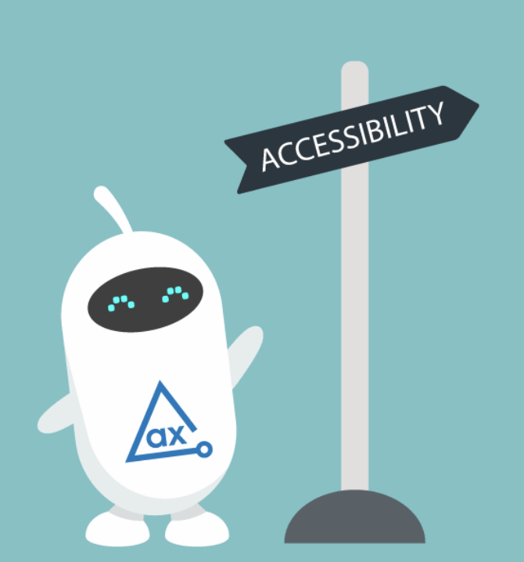
Ready to meet your friendly AI a11y assistant?
Notes:
Are you ready to meet a friendly and helpfull AI assistant for Ally?

Slide 40
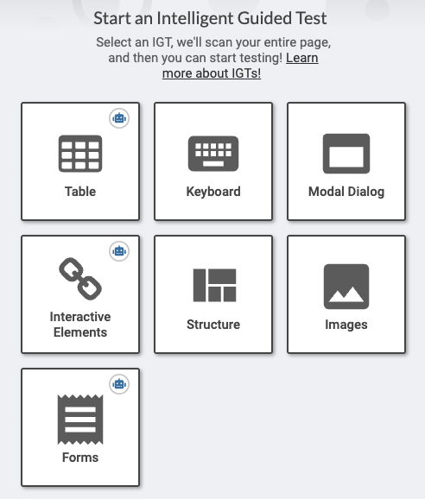
Axe DevTools Intelligent Guided Tests (IGTs) & AI
We use narrow AI in IGT
Auto detect WCAG issues
When possible
Ask YOU a focused question when AI is not sure it is a WCAG issue
Benefits
More checks are automated
and accurate!
A11Y testing can be faster
YOU get to focus your brainpower on items that Narrow AI can’t learn (or hasn’t learned yet)
Notes:
Human-centric approach respectfully assists you and frees you to use your brainpower where it is required & has the most positive impact!
Just because it looks like a button, doesn’t mean it is always a button
Just because it looks like a tab list, doesn’t mean its not just a list of links

Slide 41
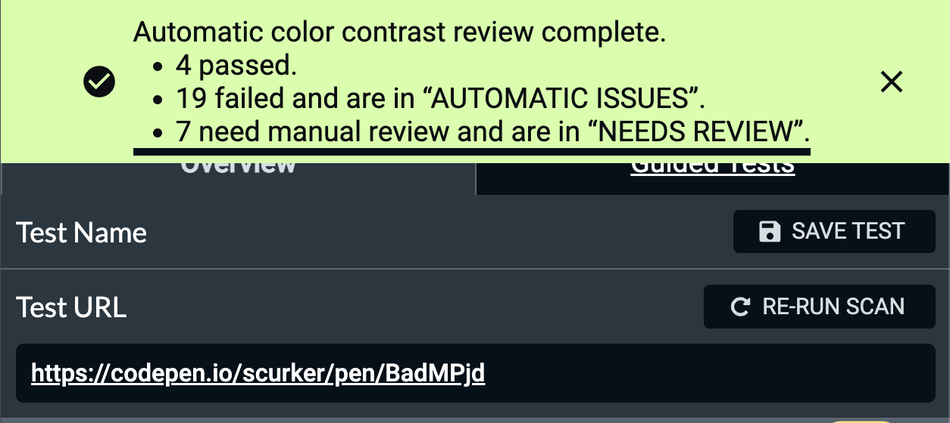
Problem: Understanding complex color contrast situations
We use visual text and background rendering
Automatically calculate the range of color contrast values
CV components use the range to determine whether there is an issue
Notes:
Problem: advanced CSS usage and/or modern design can introduce color contrast situations that are very complex to test for manually. For example, text on top of an image or complex gradient.
So, we use the visual rendering of text and background to automatically calculate the range of color contrast values and present the results to the user automatically. This calculation is not possible simply using the information available to axe-core.

Slide 42
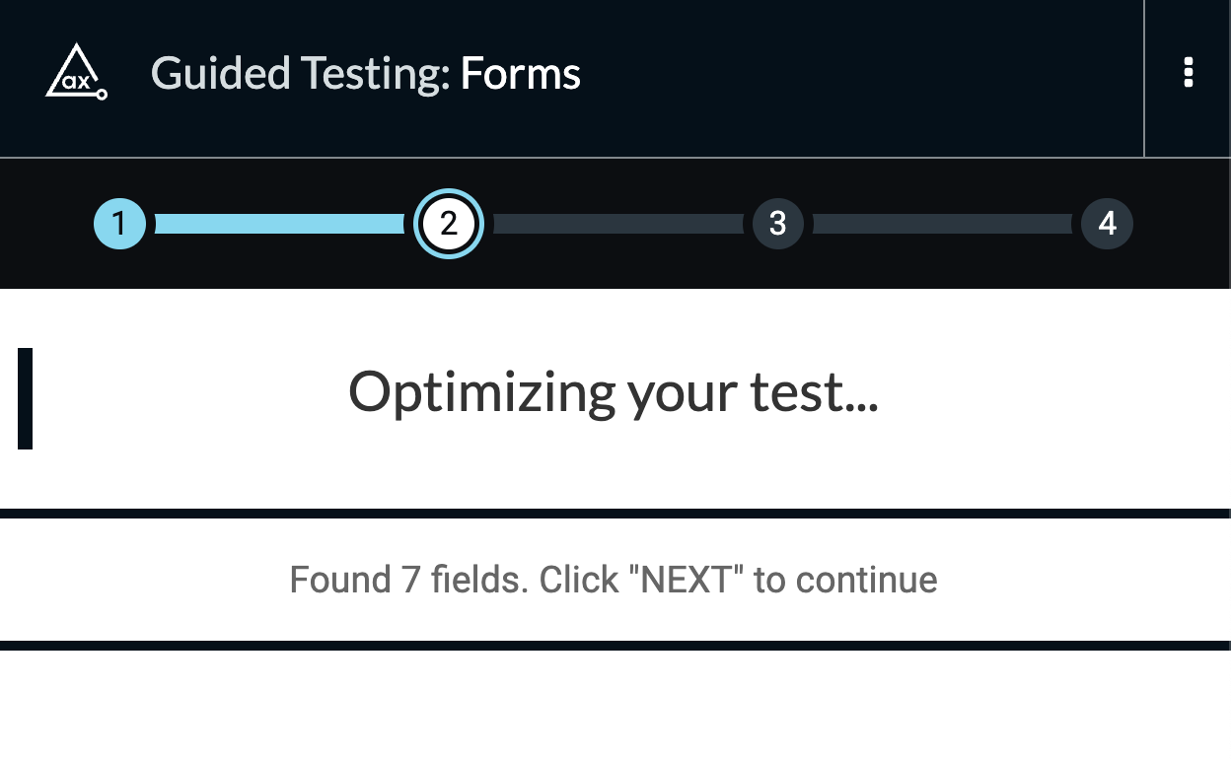
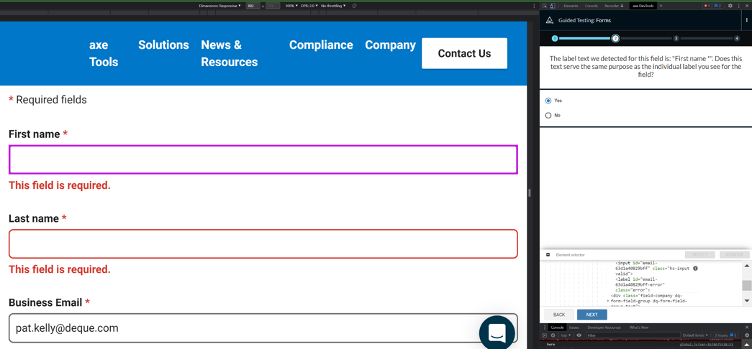
Problem: What goes with what?
Our OCR model evaluates the text associated with form labels and uses it to validate the accessible name for form fields
Notes:
Problem: What goes with what?
Humans are very good at recognizing things like “This text tells me what to put into that input field”. This association is often achieved through spatial layout where the semantics may or may not be present.
So, we use an OCR model to generate the text associated with form labels and use this text to validate the accessible name for form fields.
the result is that fewer variables are left to developers to sort through for each input - saving them a lot of time

Slide 43
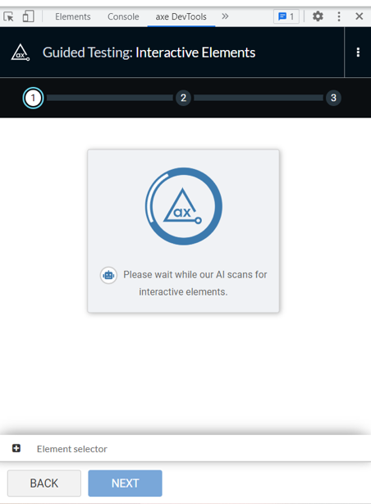
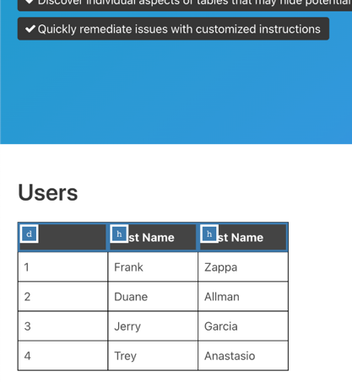
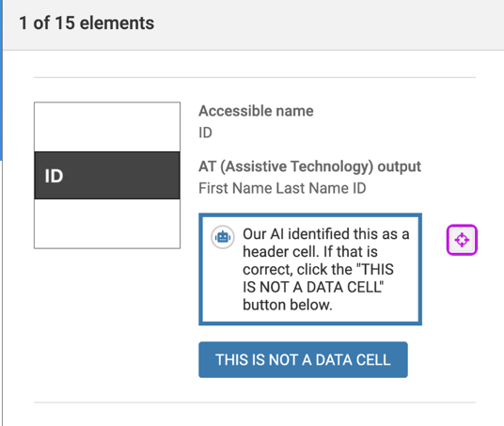
Problem: What is this?
Tables
Our object detection model ids & classifies UI objects
detects aspect ratios and sizes
combines classification with semantics & user input
recognizes single items that map to multiple semantics
Currently Covers:
forms, form fields, form field labels, data tables, data table headers and interactive elements.
More to come!
Please wait while our AI scans for table elements
Notes:
Problem: What is this?
Traditionally, we have needed to look at something on screen and say, for instance - “that’s a data table, while that similar looking thing is a layout table”. Humans are very good at cutting through size, shape, and color variations to detect object purpose.
So, we use an object detection model to identify and classify user interface objects. This model has been developed by Deque and is specialized to be able to handle the unique nature of UI object detection. One unique property is the varying aspect ratios and sizes of UI objects. These can vary from objects like layout tables that span almost the entire UI, to objects that are small and blob-shaped (like icons or check boxes), to objects like sliders or menu bars that are short and very wide, to objects like vertical navigation or menus that are very tall and thin. We combine this classification with semantic information, (from the DOM in a web application for instance), and user input in our tools (e.g. IGT) to make decisions on whether there actually are accessibility issues. We also take into account that a single item can map to multiple potential semantics. We always adhere to the axe-core manifesto of zero false positives. Our goal is to decrease the effort required to produce accessible user experiences from end to end. Specifically, today we have leveraged the following classifications: forms, form fields, form field labels, data tables, data table headers and interactive elements and combined these with heuristics to enhance our automation capabilities.

Slide 44
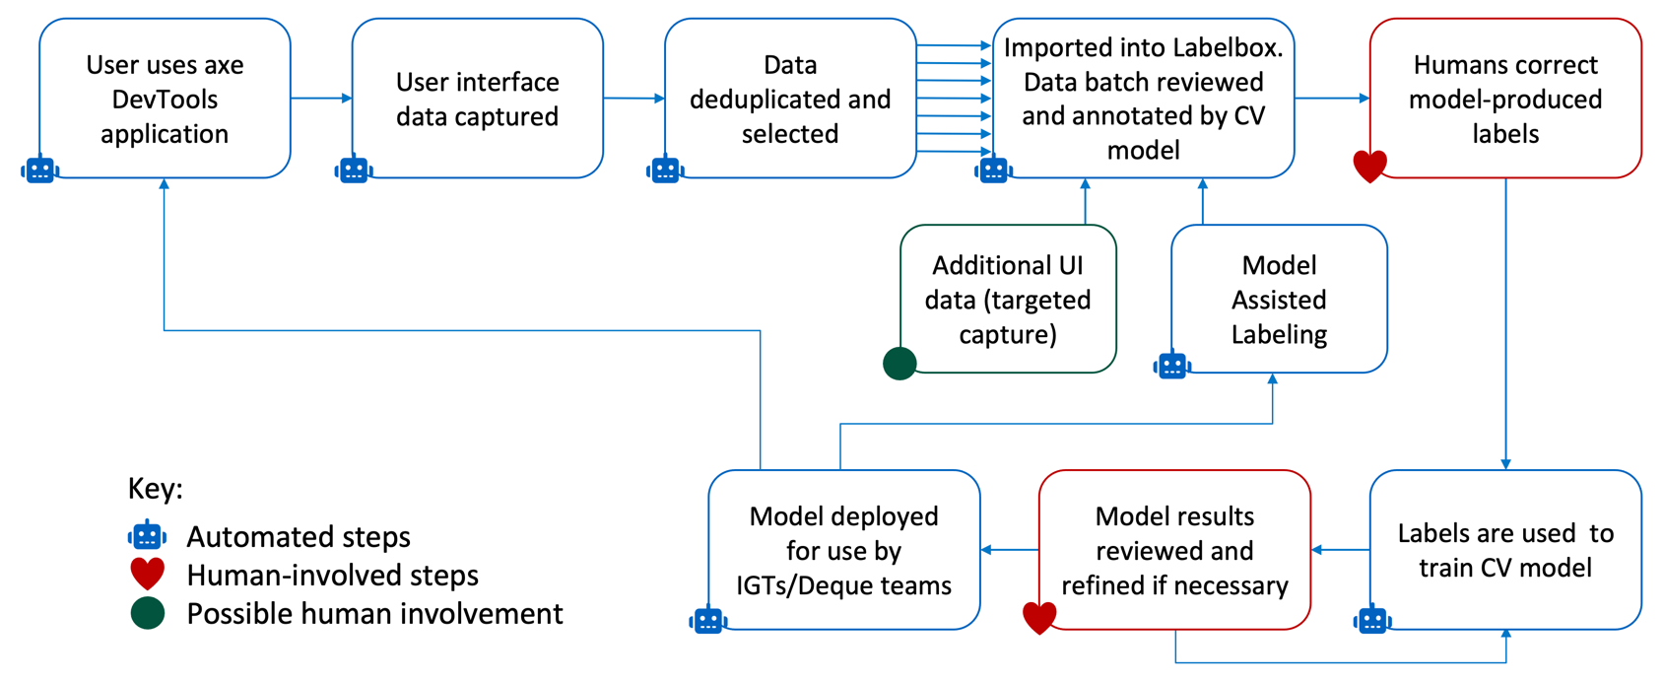
A11Y Data is a Strategic Asset
Notes:
Automated Step1: User uses axe DevTools application. 1 arrow points to step 2.
Automated Step2: User interface data captured. 1 arrow points to step 3.
Automated Step3: Data deduplicated and selected. Multiple arrows point to step 4.
Automated Step4: Imported into Labelbox. Data batch reviewed and annotated by CV model. 1 arrow points to step 5.
Human Step5: Humans correct model-produced labels. 1 Arrow points to step 6.
Automated Step 6: Labels are used to train CV model. 1 Arrow points to step 7.
Human Step7: Model results reviewed and revied if necessary. 1 arrow points forward to Step 8. Another single arrow points back to Step 5.
Automated Step 8: Model deployed to AWS service for use by IGTs/Deque teams. 1 arrow points back to step 1. 1 arrow points Step 9.
Automated Step9: Model Assisted Labeling. 1 arrow points back to step 4.
Possible Human involvement Step10: Additional UI data (targeted capture). 1 Arrow points to step 4.

Slide 45
AI and the Goldilocks Zone

Slide 46
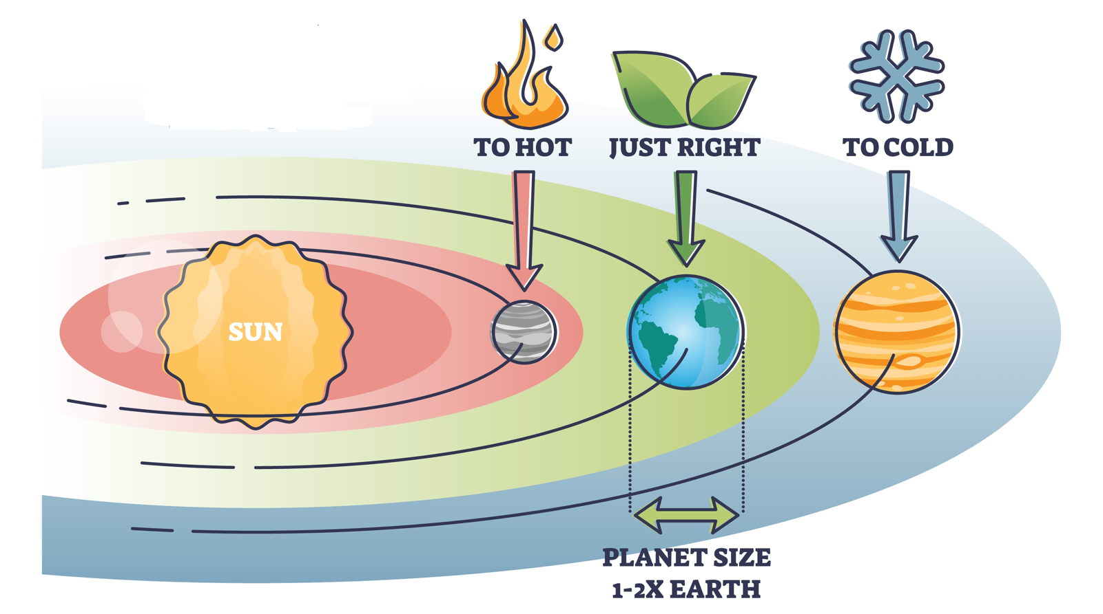
The Goldilocks Zone

Slide 47
A11Y & the Goldilocks Zone of AI
Too Hot Too Optimistic | AI can do everything!!!
Just Right Pragmatic | AI cannot do everything, but with ethical human guidance, AI will break down a11y barriers that have been resistance to our human efforts over the past 3 decades.
Too Cold Too Pessimistic | AI cannot do everything perfectly, so we cannot use AI at all.

Slide 48
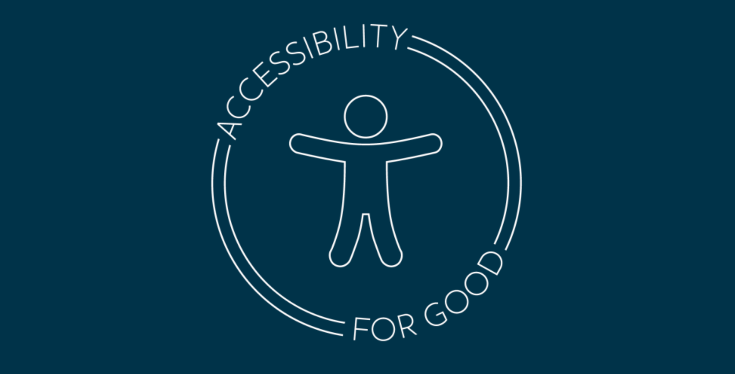
Accessibility for Good

